Slide 1


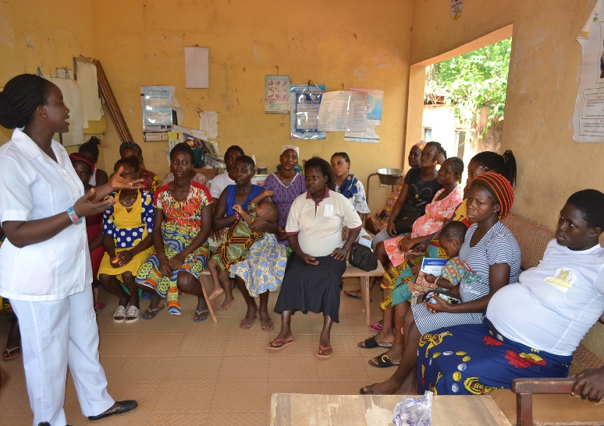
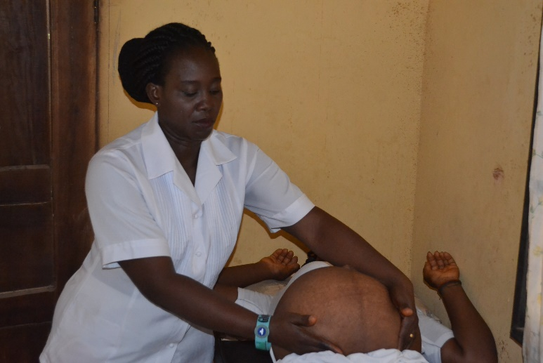
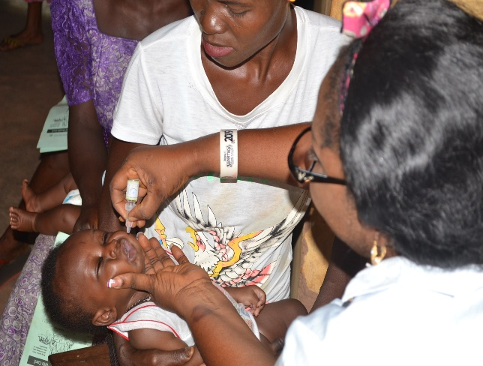
Influence of Women’s Empowerment Indices on the Utilization of Skilled Maternity Care: Evidence from Rural Nigeria
Ntoimo LFC, Okonofua FE, Aikpitanyi J, Yaya S, Johnson E, Sombie I, & Aina O
Current evidence shows that skilled maternity care is still a big public health problem in Nigeria.
In 2018, 67% of women of reproductive age who were pregnant in the fives years before the 2018 NDHS received skilled antenatal care, 39% delivered in a facility, and 42% received postnatal care.
This figure is even lower in the rural areas - 56%, 26%, 30%
The WHO as well as Nigeria’s FMoH recommend all three levels of care to prevent maternal death.
Issue/Objective
Skilled Antenatal care
Skilled Delivery care
Skilled postnatal care
Objective: To examine the role of women empowerment indices in the probability of receiving all three levels of skilled maternity care in rural Nigeria.
Resource Domain
Highest level of education
Employment status
Ownership of land or house
Who pays for respondent’s health care
Received all three
Results
Methods
Household Survey
Women age 15-45 [mean age 30.3 ±6.8] years in a union in two rural Local Government areas in Edo State, Nigeria, who have had a live birth in the five years preceding the survey.
Sample size
1,245 randomly selected in households
Theoretical framework
Model of the utilization of health services (Andersen and Newman, 2005)
Analytical Framework
Decision Domain
Participation in decisions on:
Respondent’s health
Respondent’s Earning
Major purchases
Visits to family/relatives
Food to be cooked
Outcome - received maternal health care (antenatal, delivery, and postnatal care in a health facility)
Harvard Gender Roles Framework
Infleuncer Domain
Religion
Marital Status
Age at first marriage
Number of co-wives
Spousal age gap
Spousal gap in education
72% utilization is impressive but of note is that most of the women used Primary Health Centres where the quality of care may not be optimal.
Results
Contribution
Contributes to existing evidence to achieve zero preventable maternal mortality and SDG 3 of <70 MMR
Received less than three
Results
Decision-making Domain
Participation of women alone in decision-making about major purchases, which is indicative of a decline in male dominance, was a positive predictor of skilled maternity care, whereas participating alone in decisions about food to be cooked every day was an inverse predictor. This is because domestic chores such as cooking is still considered a woman's sphere in many of Nigeria's patriarchal cultures. Thus, it is a norm which does not ascribe any special empowerment attributes to women.
Infleuncer Domain
Belonging to a non-Catholic denomination predicts higher odds of using a health facility for skilled maternity care. Non-Catholics Christians are more liberal in sexual and reproductive health.
Being in a consensual union is a negative predictor of skilled maternity care. Interventions to remove barriers to formalization of marriage such as high bride wealth and expensive wedding ceremonies is recommended to increase the number of women who benefit from the institutional and other advantages of a formal union that are associated with better health.
Results
Adjusting all the domains and other characteristics
Resource Domain
Education is a significant empowerment resource, indicating that sustainable improvement in maternal health indicators in Nigeria is dependent on every woman attaining at least a primary education.
Ownership of land or house as a significant inverse predictor speaks to the fact that compared to men, women in many Nigerian communities do not own high quality and substantial assets that translates into strong resource empowerment that can positively affect use of skilled maternity care.
Funded by The International Development Research Centre (IDRC) in partnership with Global Affairs Canada (GAC), and the Canadian Institute of Health Research under the Innovating for Maternal and Child Health in Africa (IMCHA) Initiative

